Slide 1

Department of Computer Science and Engineering
Course Code : 18CSS84
PROJECT PHASE 2 REVIEW 2 PRESENTATION
ON
CROSSOVER RECOGNITION OF LUNG INFECTIONS WITH CHEST X-RAY IMAGES UTILIZING CNN
Guided by:
PROF. VISHESH J
Assistant Professor
Department of CSE
Presented by:
LIKHITHA B H : 1DB19CS080
NEHA R RAO : 1DB19CS095
RUCHITHA M : 1DB19CS165
LATHARANI : 1DB20CS405

Slide 2
AGENDA
ABSTRACT
INTRODUCTION
LITERATURE SURVEY
PROBLEM STATEMENT
EXISTING SYSTEM
PROPOSED SYSTEM
OBJECTIVES
SYSTEM REQUIREMENTS
SYSTEM DESIGN
METHODOLOGY
IMPLEMENTATION
SNAPSHOTS
RESULTS
CONCLUSION
REFERENCES

Slide 3

ABSTRACT
The on-going COVID-19 outbreak made healthcare systems across the globe to be in the edge of the battle.
The early and auto diagnosis helps people to be precautious.
The proposed work aims to detect COVID-19 , Pneumonia, Tuberculosis and Lung Cancer patients from X-Rays .
A suitable Convolutional Neural Network Model is selected for the identified dataset.
In this model, the features from the images are extracted which will lead the foundation for distinguishing between the different lung diseases, and then those extracted feature set would pass through the classifier for the prediction.

Slide 4
INTRODUCTION
At first, the COVID-19 outbreak was declared by Wuhan, China in December 2019 which was highly widespread by March 2020.
Early detection of COVID-19, pneumonia, tuberculosis and lung cancer is critical for curative therapy and increasing survival rates. There is also a chance that the diagnosis of these diseases could return a false positive result.
Hence, the aim of this study is to simplify the process of detecting and differentiating the COVID-19, pneumonia and lung cancer using the concept called CNN (Convolutional Neural Network).

Slide 5
LITERATURE SURVEY
SL NO. | AUTHOR | TITLE | PUBLISHED YEAR | BRIEF DESCRIPTION
1. | Kanakaprabha.S, et.al,[ | Analysis of COVID-19 and Pneumonia Detection in Chest X-Ray Images using Deep Learning | 2021 | The proposed work aims to detect the Normal lungs, COVID19 Infected lungs, Pneumonia Infected lungs from the X-Ray images.
2. | Afonso U. Fonseca, et.al,[ | Screening of Viral Pneumonia and COVID-19 in Chest X-ray using Classical Machine Learning. | 2021 | A study to explore classic machine learning methods for the automatic detection of COVID-19 pneumonia cases from CXR images.
3. | Mohammad Farukh Hashmi, et.al | Efficient Pneumonia Detection in Chest Xray Images Using Deep Transfer Learning | 2020 | The proposed methodology uses a deep transfer learning algorithm that extracts the features from the X-ray image that describes the presence of disease automatically and reports whether it is a case of pneumonia.

Slide 6
LITERATURE SURVEY
SL NO. | AUTHOR | TITLE | PUBLISHED YEAR | BRIEF DESCRIPTION
4. | Saeed S. Alahmari, et.al, | A Comprehensive Review of Deep Learning-Based Methods for COVID-19 Detection Using Chest X-Ray Images. | 2022 | This review paper summarizes deep learning approaches for COVID-19 detection using chest X-ray images and provide potential improvements for higher accuracy.
5. | Vinod Kumar, et.al, | Detection system for lung cancer based on neural network: X-Ray validation performance. | 2013 | In this paper, the author developed a lung cancer detection system for early detection of lung cancer by studying lung Xray images using number of steps.

Slide 7

PROBLEM STATEMENT
Deep learning has advanced medical image segmentation, providing powerful diagnostic tools.
Early detection of COVID-19 is crucial, making this technology even more important.
Hence, an image classification model is built to detect and categorize the chest X- Ray images into Normal, Pneumonia, Tuberculosis, COVID-19 and Lung Cancer using chest X Ray images in CNN.

Slide 8

EXISTING SYSTEM
The existing system uses Convolutional Neural Networks (CNN) to classify chest X-Ray images into four categories: identifying affected lungs, identifying pneumonia affected lungs, identifying COVID-19 affected lungs, and identifying pneumonia and COVID-19 affected lungs.
The CNN model is trained on a dataset of X-Ray images labeled with their corresponding categories.
The system can be useful in identifying patients with COVID-19 and pneumonia, enabling timely medical intervention and reducing the spread of infection

Slide 9

PROPOSED SYSTEM
The proposed system for classifying lung diseases from chest X-ray images involves four main steps: preprocessing, feature selection, feature extraction, and classification.
The extracted features are classified into normal, COVID-19, pneumonia, tuberculosis, or lung cancer using a suitable classification algorithm.
Additional features such as an SMS is sent to the respective individual regarding the name of the disease if any and a suitable hospital for the disease diagnosed.
The accuracy of the model is around 97%, making it a highly beneficial tool for identifying lung diseases.

Slide 10

OBJECTIVES
The Main objective of the project is to detect Lung diseases in patients using Chest X-Ray Images through the following steps:
Upload X-Ray Images - The system should be capable of getting X-Rays from users that will be utilized by the Model.
Detection of Hybrid Model - The system should be able to detect the COVID-19, Pneumonia, Tuberculosis and Lung Cancer within the X – Ray images that users have uploaded.
Display Results - The system should be able to give information that the user can appropriately understand and gain insight from it.

Slide 11

SYSTEM REQUIREMENTS
Hardware Requirements:
System : Intel Core i3/i5
Hard Disk : 40 GB
Monitor : 15 VGA Color
Ram : 512 Mb Minimum
Software Requirements:
Operating system : Windows XP/ Windows 7 or More
Software Tool : IDLE or VScode
Coding Language : Python

Slide 12
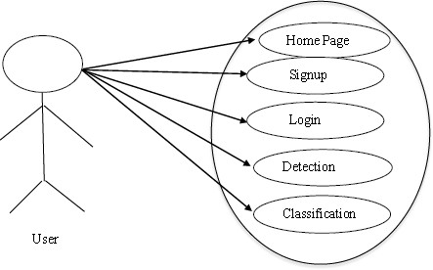
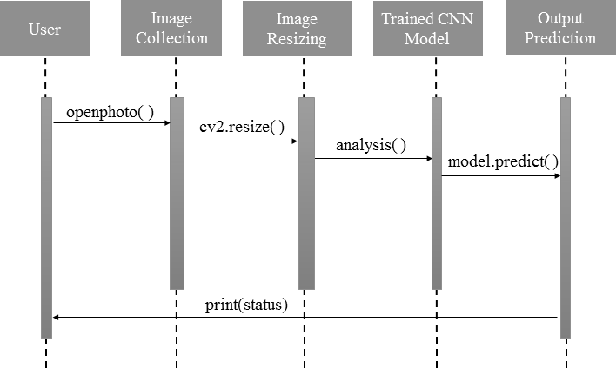
SYSTEM DESIGN
FIG : USE CASE DIAGRAM
FIG : SEQUENCE DIAGRAM

Slide 13
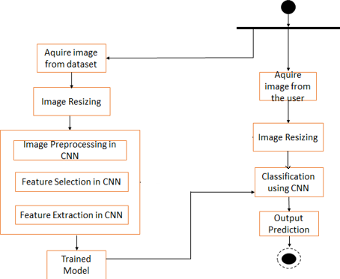
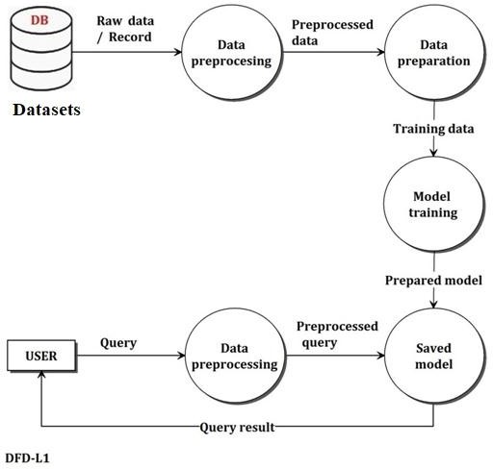
SYSTEM DESIGN
FIG : DATAFLOW DIAGRAM
FIG: ACTIVITY DIAGRAM

Slide 14

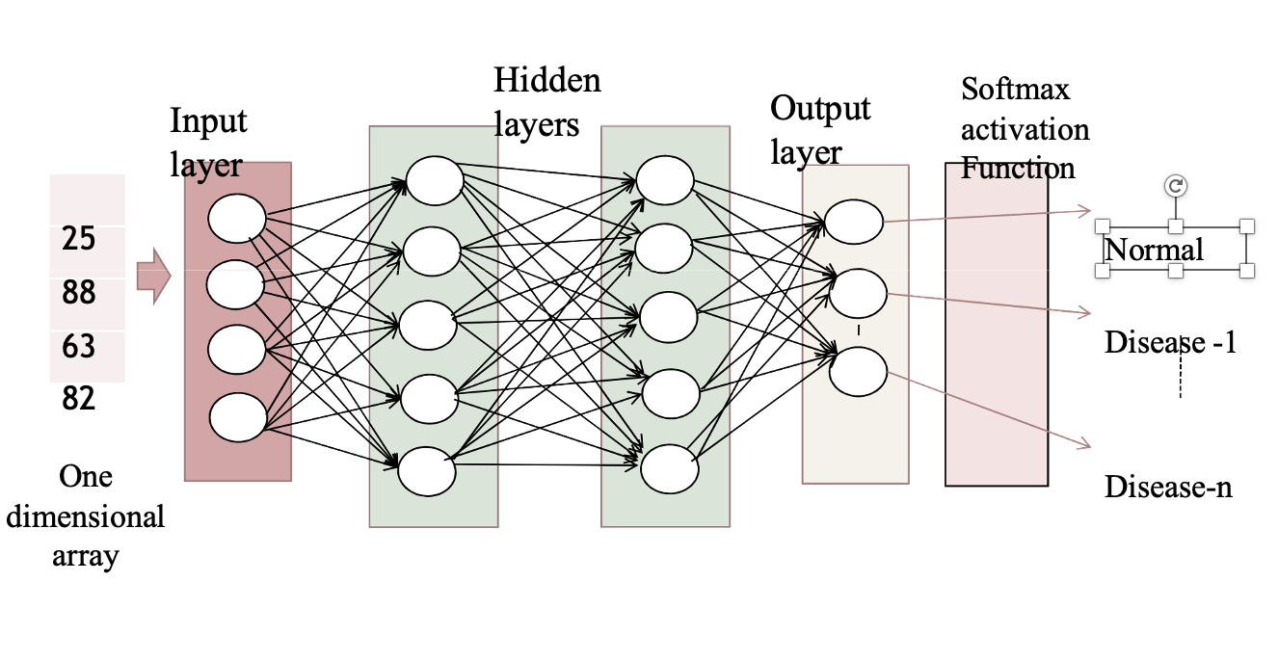
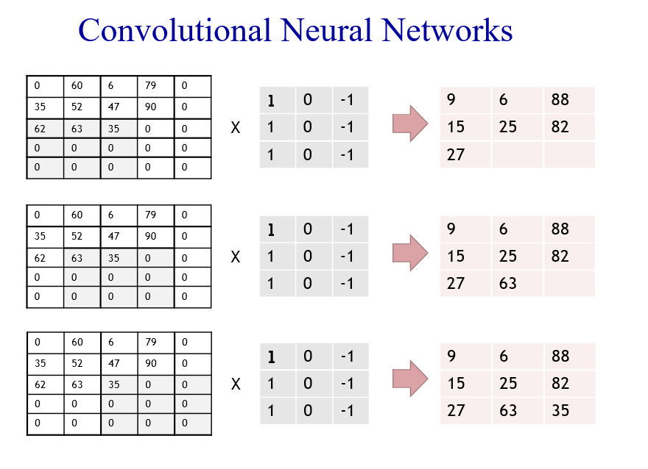
METHODOLOGY
FIG : CNN LAYERS

Slide 15
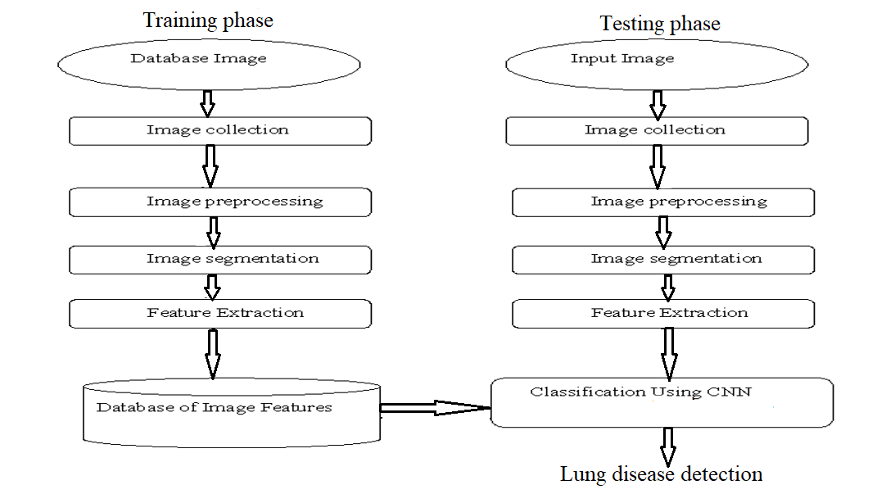
IMPLEMENTATION
SYSTEM ARCHITECTURE

Slide 16

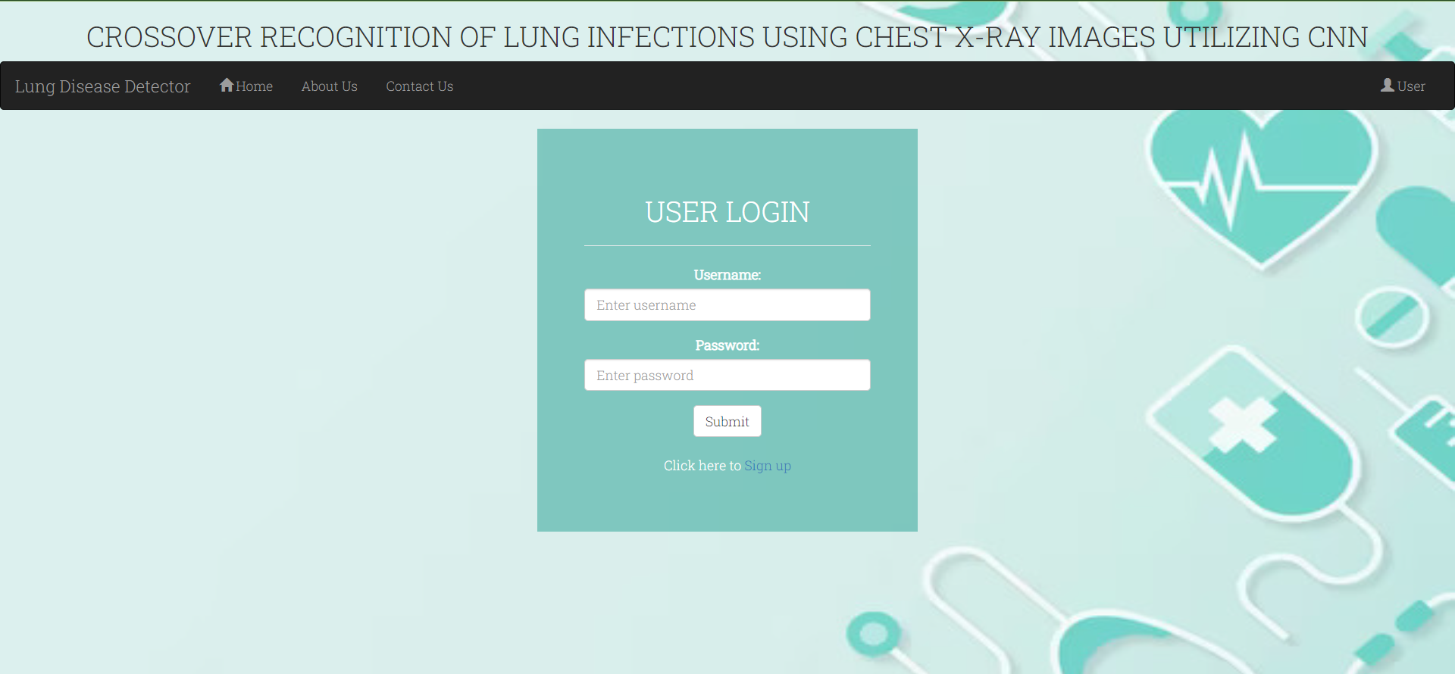
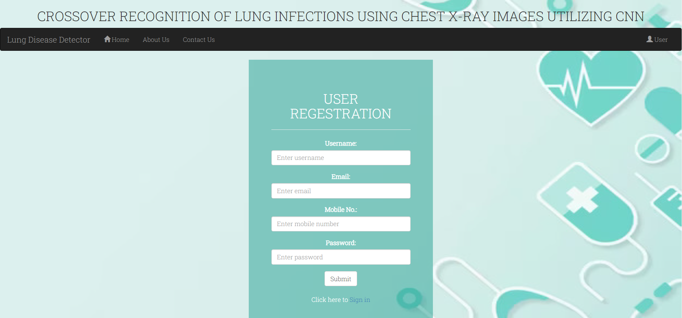
SNAPSHOTS
FIG : LOGIN PAGE
FIG : REGISTRATION PAGE

Slide 17
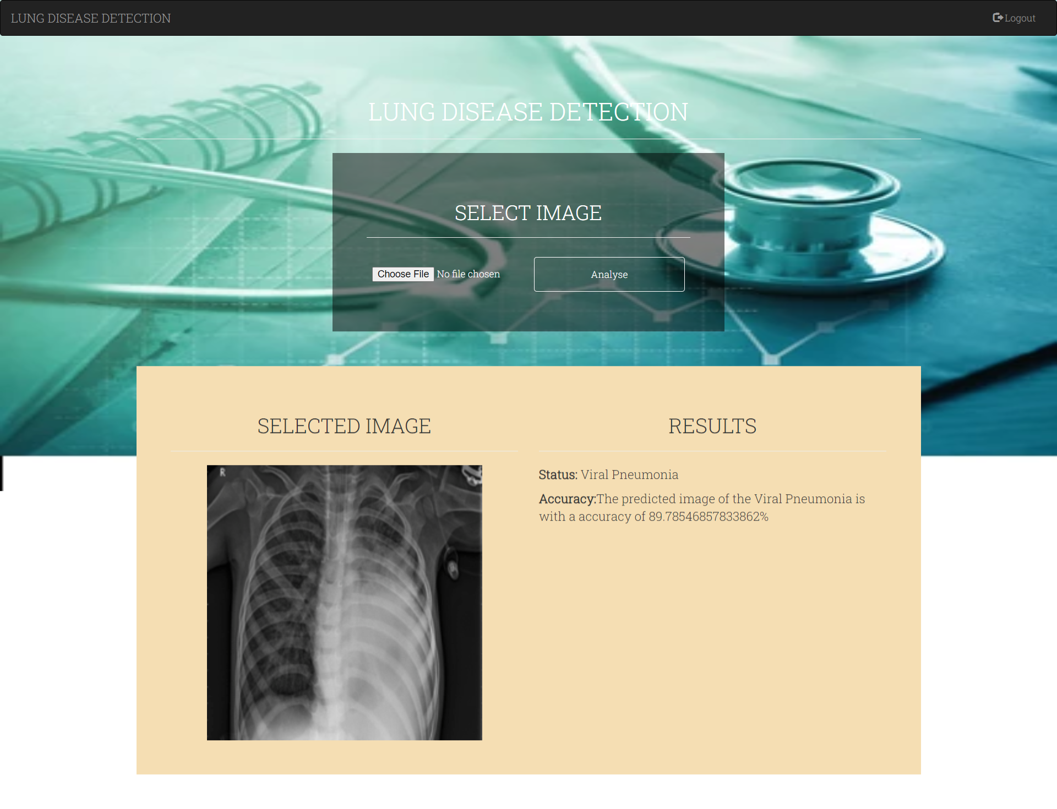
SNAPSHOTS
FIG : RESULTS PAGE

Slide 18

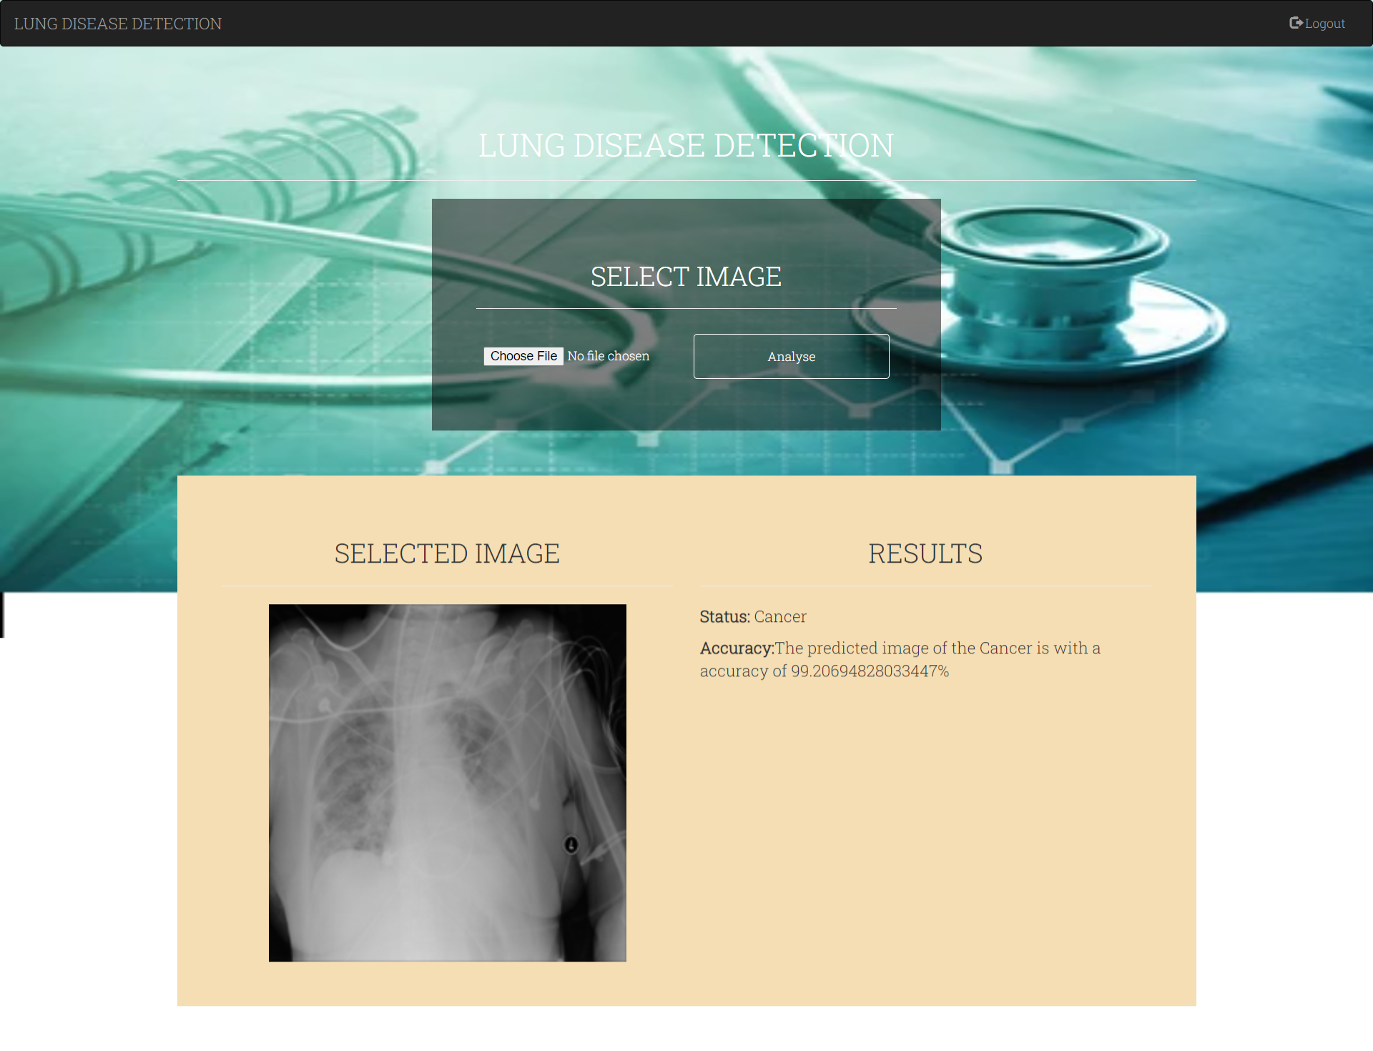
RESULTS
FIG : DETECTION OF LUNG CANCER
FIG : DETECTION OF PNEUMONIA

Slide 19
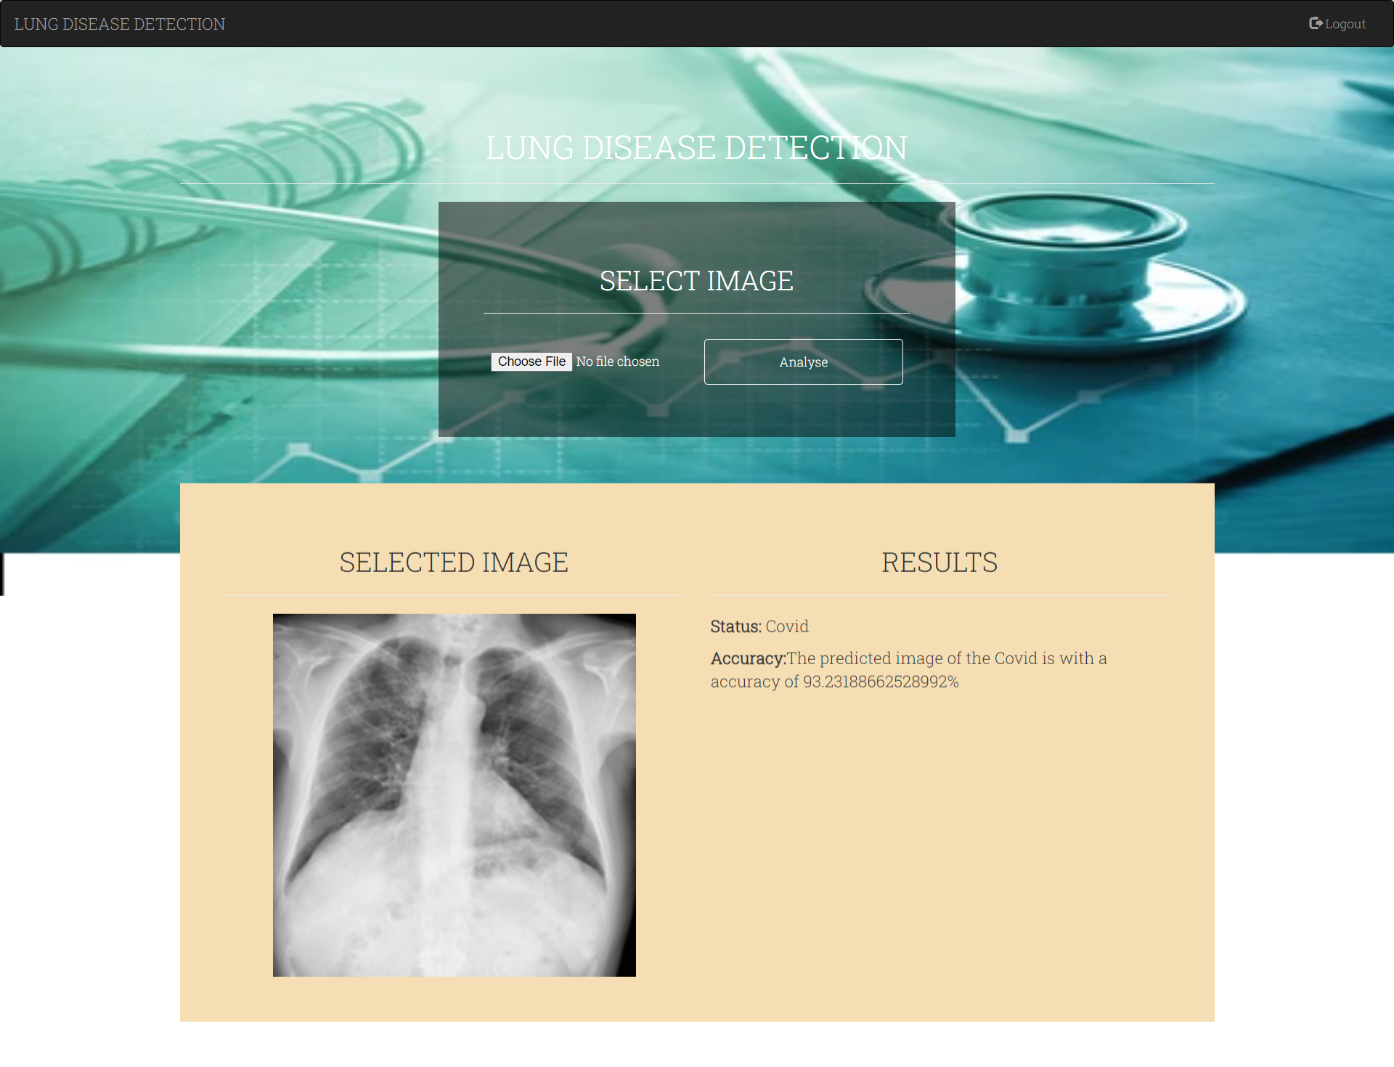
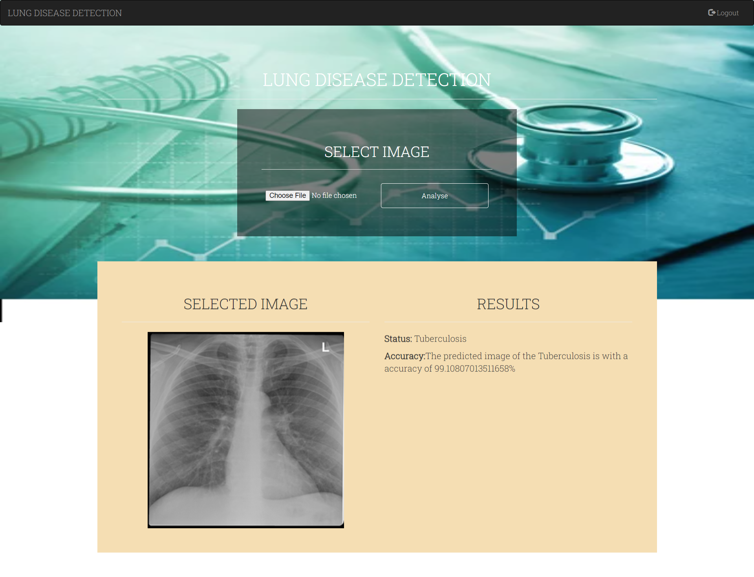
RESULTS
FIG : DETECTION OF COVID-19
FIG : DETECTION OF TUBERCULOSIS

Slide 20
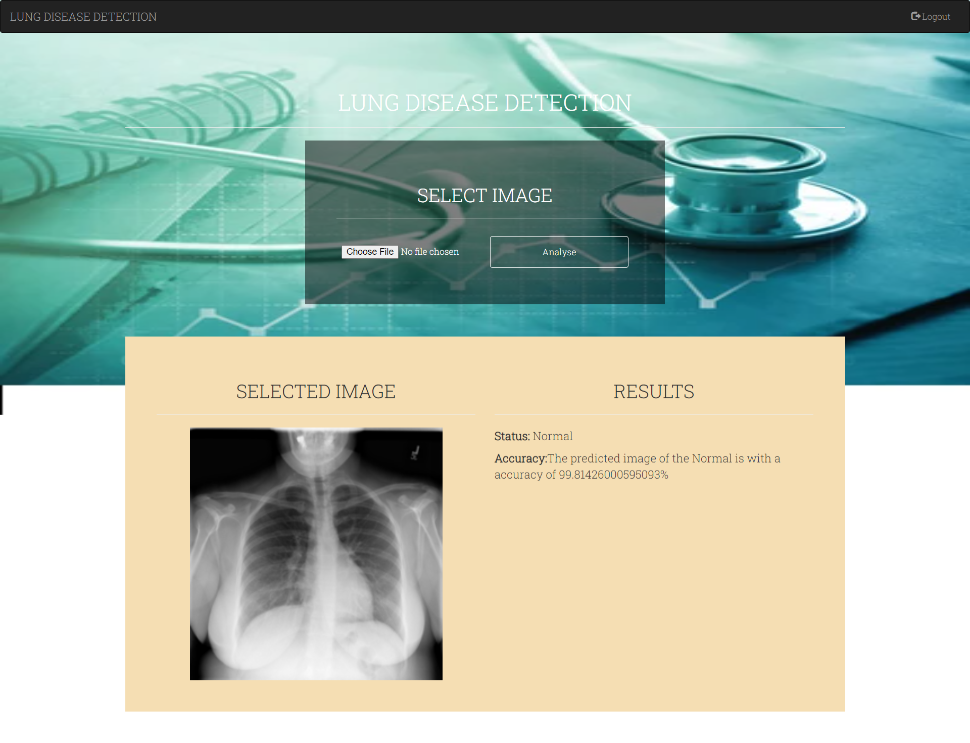
RESULTS
FIG : DETECTION OF NORMAL LUNGS

Slide 21

CONCLUSION
The proposed work involves using a CNN model to detect different lung diseases from X-Ray images, including Normal lungs, COVID-19 Infected lungs, Pneumonia Infected lungs, Tuberculosis infected lungs, and lung cancer infected lungs.
The model achieves an accuracy of around 99% with limited cost and computational requirements, making it a valuable tool for medical practitioners and researchers.
Additionally, the work can be extended by combining multiple models into an ensemble and incorporating additional features to improve accuracy even further.

Slide 22
REFERENCES
Kanakaprabha. S., D. Radha. (2021). Analysis of COVID-19 and Pneumonia Detection in Chest X-Ray Images using Deep Learning.
Afonso U. Fonseca, et.al,(2021). Screening of Viral Pneumonia and COVID-19 in Chest X-ray using Classical Machine Learning.
Mohammed Farukh Hashmi, et.al, (2020). Efficient Pneumonia Detection in Chest Xray Images Using Deep Transfer Learning.
Saeed S. Alahmari, et.al,(2022). A Comprehensive Review of Deep Learning-Based Methods for COVID-19 Detection Using Chest X-Ray Images
Vinod Kumar, et.al,(2013). Detection system for lung cancer based on neural network: X-Ray validation performance.

Slide 23
THANKS!

